Slide 1
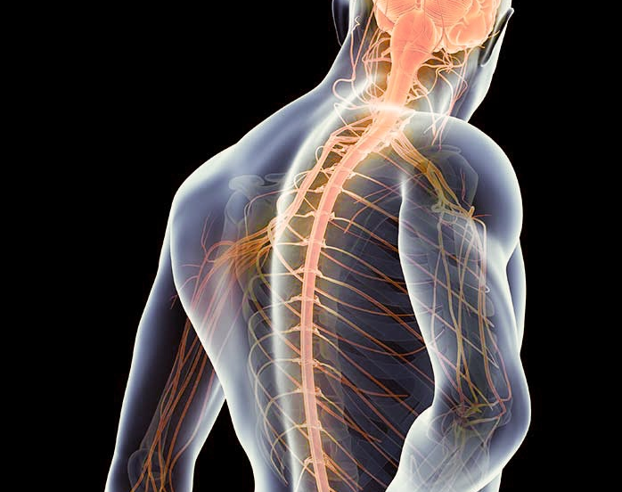
The Role Of Concomitant TBI In Developing Neuropathic Pain After SCI
Keziah Skein, PhD candidate
The University of Adelaide

Slide 2
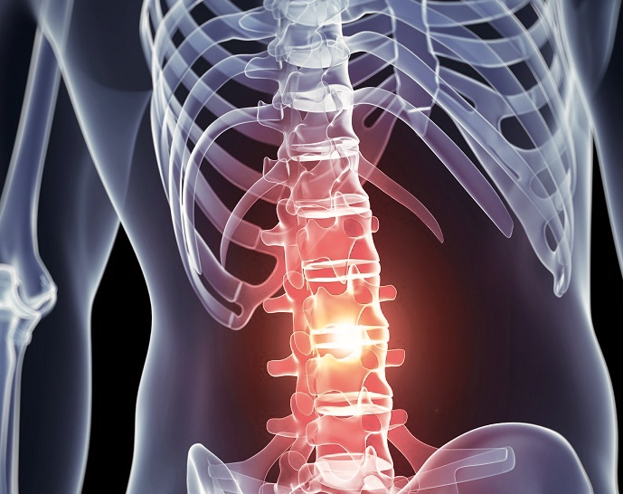
Spinal Cord Injury
180,000 new cases each year worldwide
245 new cases each year in Australia
39% of SCI cases are caused by motor vehicle accidents (in Australia)

Slide 3
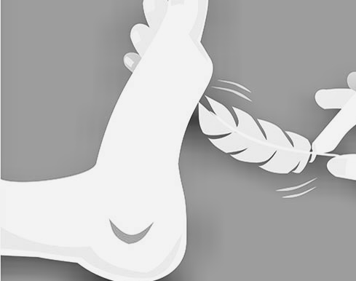
Neuropathic Pain
Unproportionate painful response to stimuli
Can be spontaneous or evoked
Chronic
Can be persistent or intermittent

Slide 4
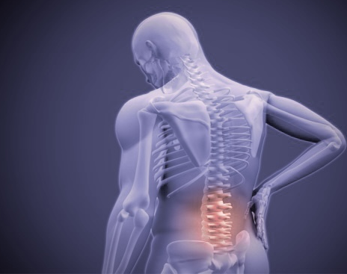
Neuropathic Pain In SCI
80% of spinal cord injury patients are in pain
60% of patients suffer from neuropathic pain
Neuropathic pain related to SCI increases with time

Slide 5
Neuropathic Pain In SCI
Predictors of pain poorly identified and obscure
Mechanism of neuropathic pain not fully known
Change in stimulation of neurons at spinal cord level
Changes in interpretation of pain signals in brain
Currently the extent and location of the injury does NOT correlate with severity of pain

Slide 6
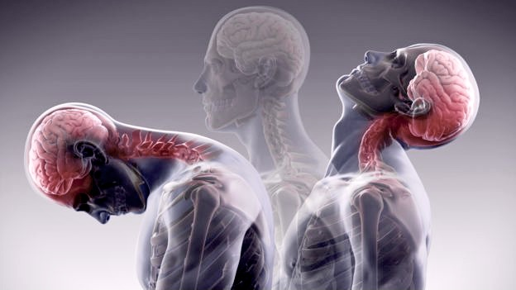
Concomitant Injury
Describes the sustaining of a traumatic brain injury at the same time as the SCI
TBI occurs in 40% of SCI cases
Prevalence of concomitant TBI in SCIs caused by MVA is 12%

Slide 7
Concomitant Injury And Neuropathic Pain
Neuropathic pain involves miscommunication at spinal cord and at brain level
Transmission of pain messages up the spinal cord
Interpretation of pain messages in the brain

Slide 8
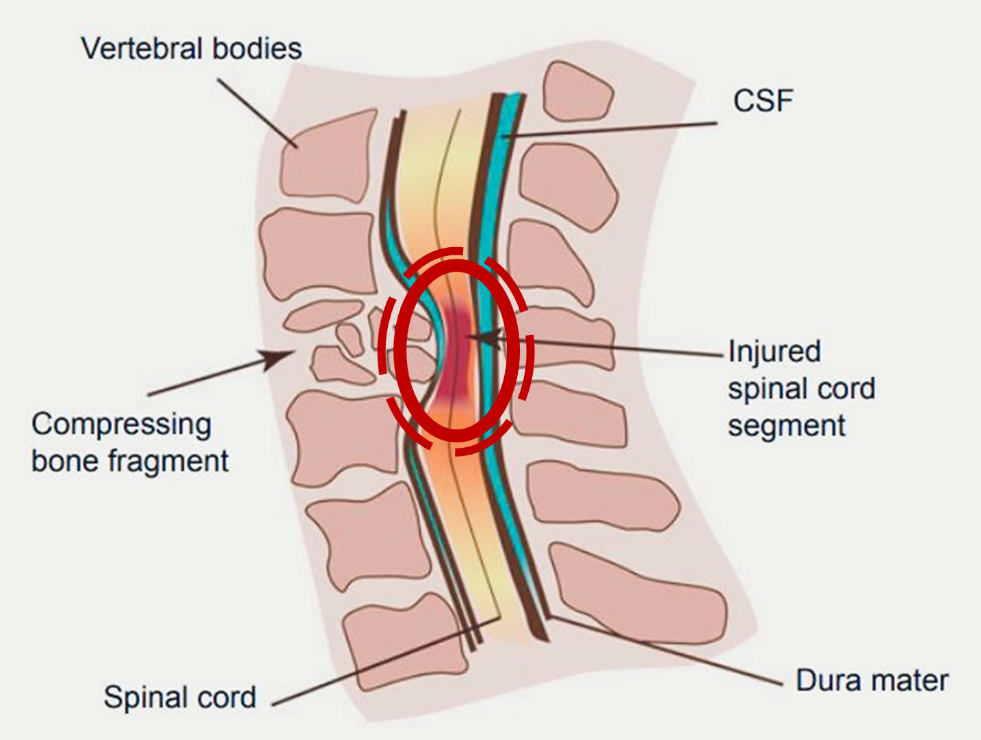
Spinal Cord Injury And Traumatic Brain Injury
Primary injury
Mechanical force
At time of injury
Secondary injury
Series of inflammatory reactions that exacerbates the injury
Over hours, days and weeks after injury

Slide 9
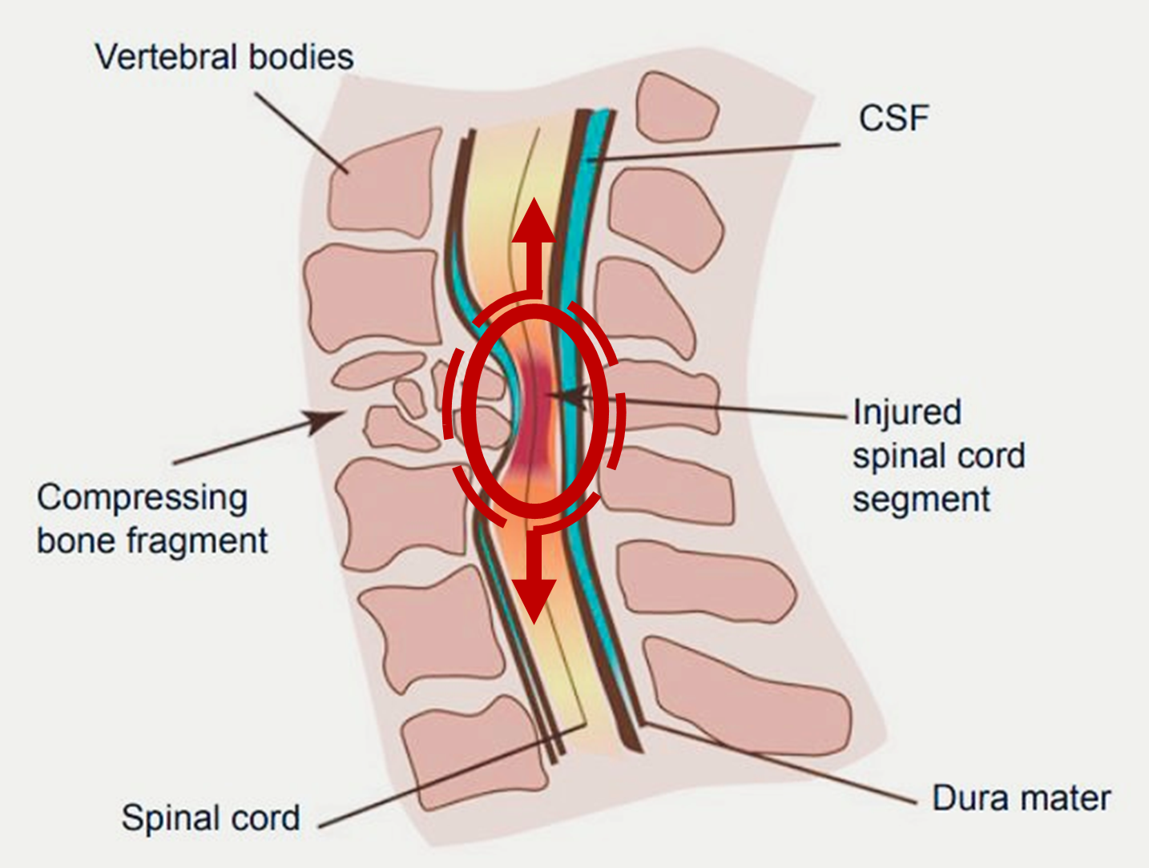
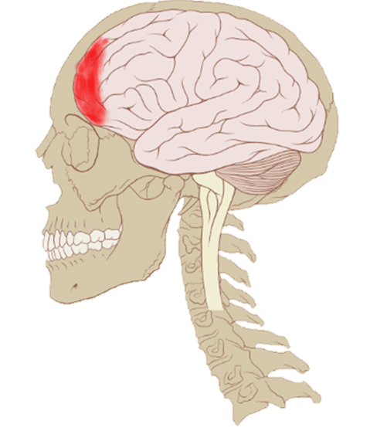
Spinal Cord Injury And Traumatic Brain Injury
Primary injury
Mechanical force
At time of injury
Secondary injury
Series of inflammatory reactions that exacerbates the injury
Over hours, days and weeks after injury
Extended timeframe of secondary injury allows for intervention

Slide 10
Neuropathic Pain After SCI Or TBI
SCI changes pain signals that are sent to the brain
TBI changes interpretation of signals

Slide 11
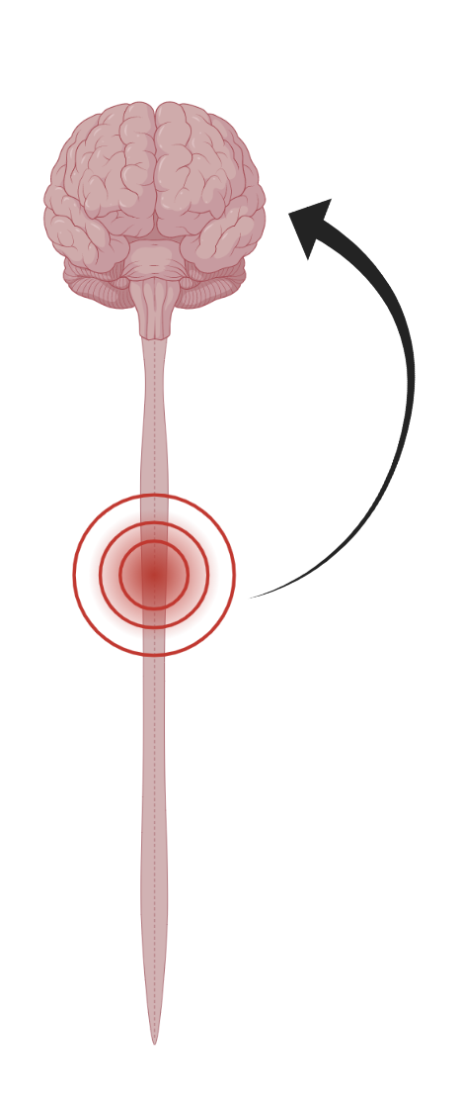
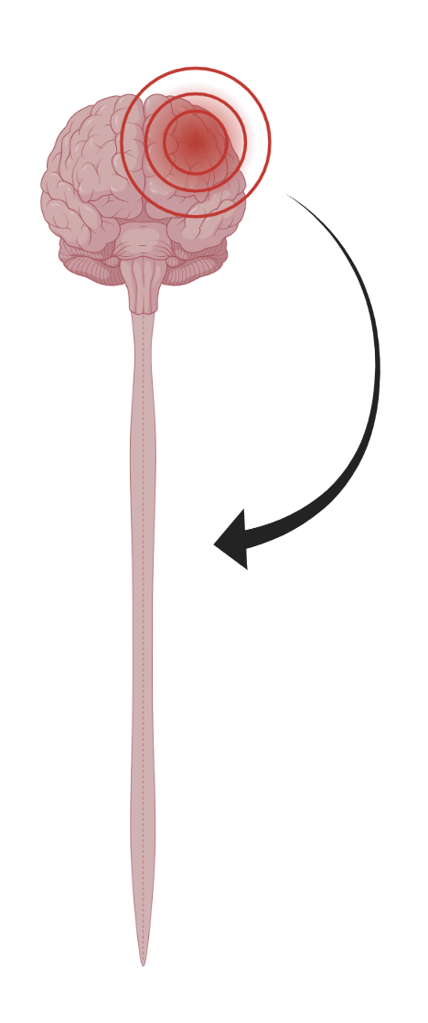
Neuropathic Pain After SCI With A TBI
Does injury at one location have an effect on another location?
Does concomitant injury (“double hit”) result in a more profound presentation of neuropathic pain?

Slide 12
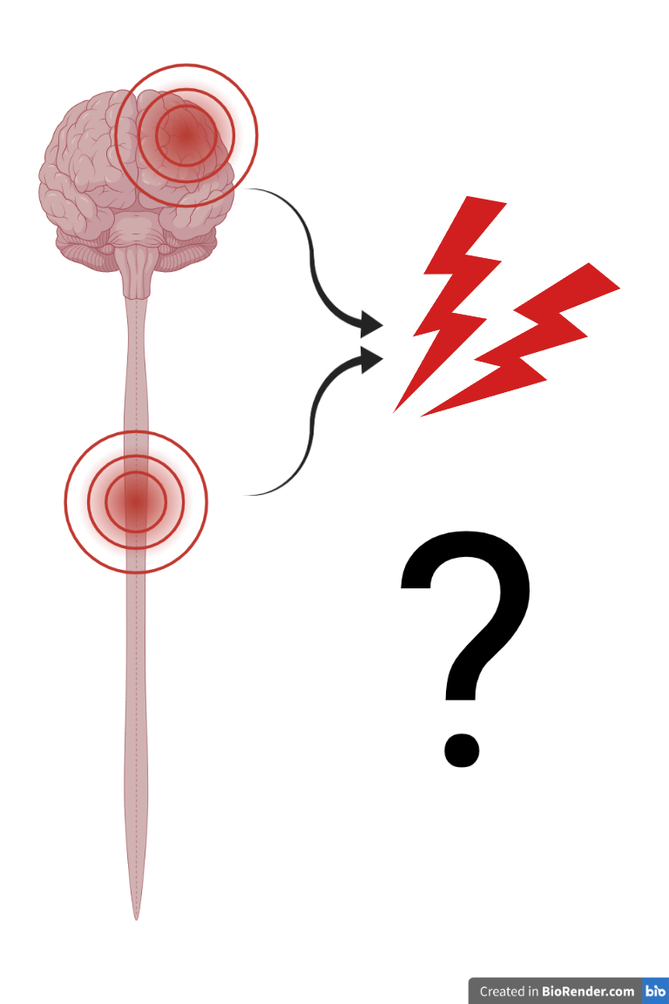
Neuropathic Pain After SCI With A TBI
Does injury at one location have an effect on another location?
Does concomitant injury (“double hit”) result in a more profound presentation of neuropathic pain?

Slide 13
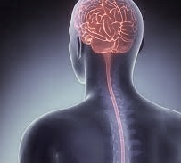
Future Directions
Development of a diagnostic markers in the blood that can predict neuropathic pain regardless of the type of injury

Slide 14
Acknowledgements
Translational Neuropathology Laboratory

